Slide 1
Checking the Chains at the Gate
Building Supply Chain Policies with Gatekeeper and Ratify
Jeremy Rickard

Slide 2

Hallo!

Slide 3
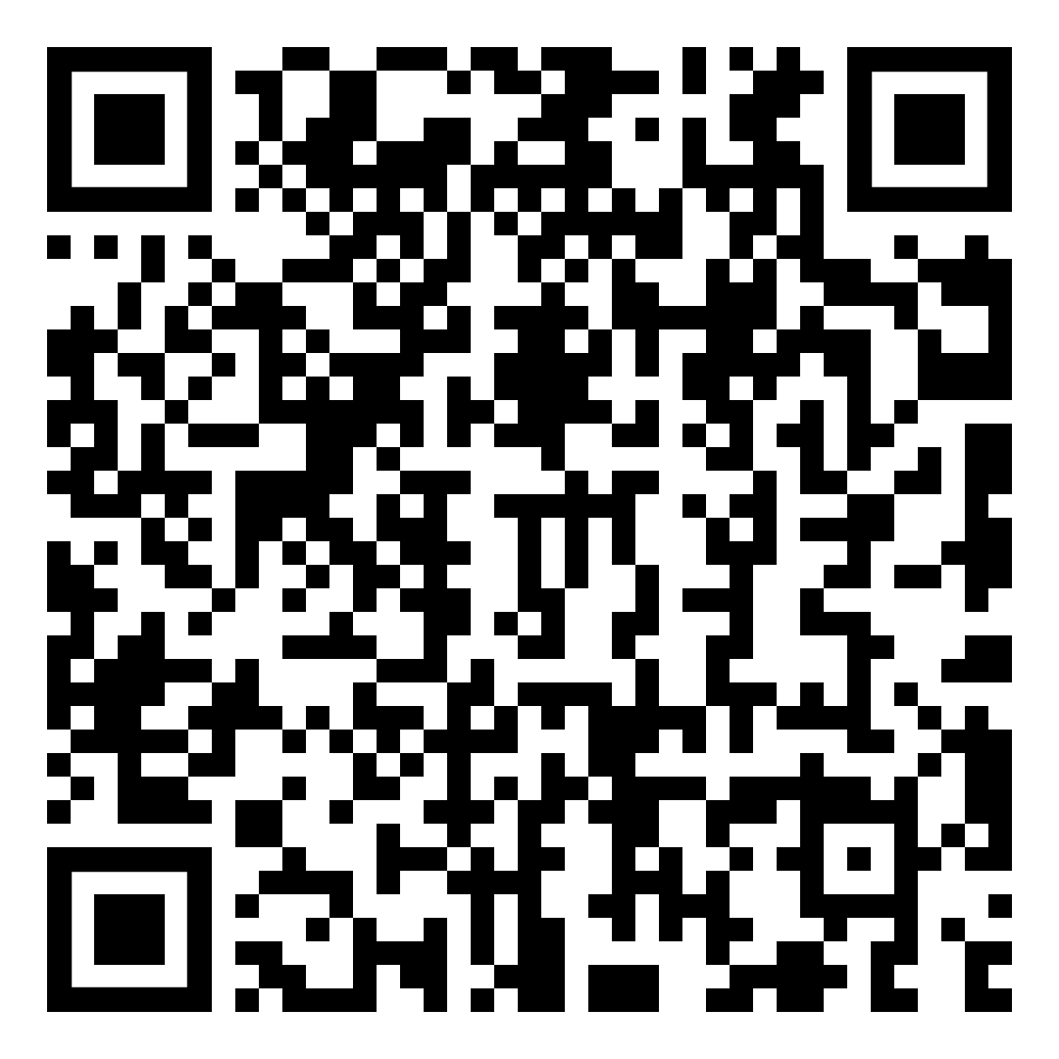

Code of Conduct
Remember the Golden Rule: Treat others as you would want to be treated - with kindness and respect
Scan the QR code to access and
review the CNCF Code of Conduct:

Slide 4
Session Q+A
Virtual attendees may submit questions to speakers through the CNCF Slack channel: #2-Kubecon-sessions
Please create a thread and tag me (@Jeremy Rickard) with questions about my talk.
Questions will be answered by me and/or other community members after the session concludes.

Slide 5
“In order to facilitate vulnerability analysis, manufacturers should identify and document components contained in the products with digital elements, including by drawing up a software bill of materials.”
Proposal for a REGULATION OF THE EUROPEAN PARLIAMENT AND OF THE COUNCIL on horizontal cybersecurity requirements for products with digital elements and amending Regulation (EU) 2019/1020

Slide 6

And a bunch of other things…

Slide 7
Can we use this new things to make automated decisions?

Slide 8

How do we enforce policies and control what’s in our cluster

Slide 9
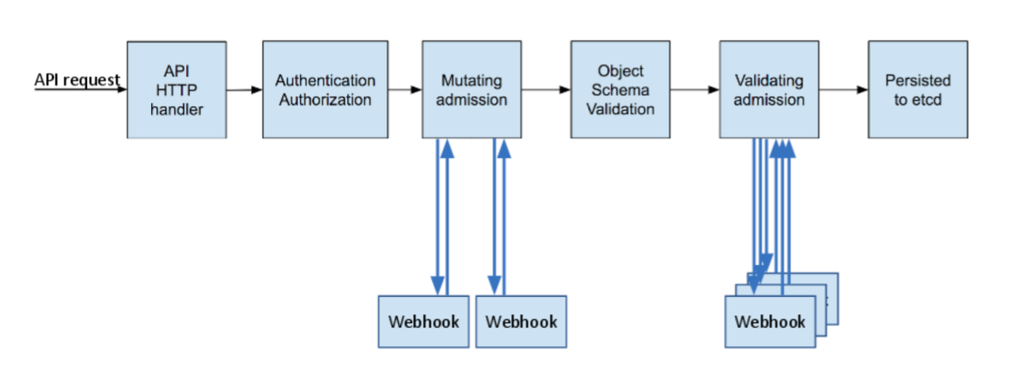
Admission Controllers to the rescue!
https://kubernetes.io/blog/2019/03/21/a-guide-to-kubernetes-admission-controllers/

Slide 10

Gatekeeper

Slide 11
How Does It Work?
Constraint Templates and Constraints

Slide 12
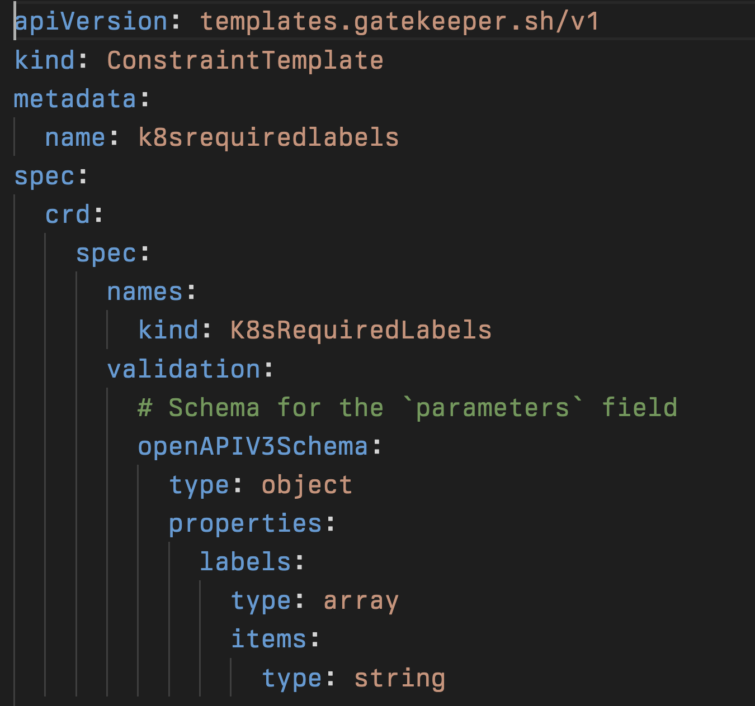

Slide 13
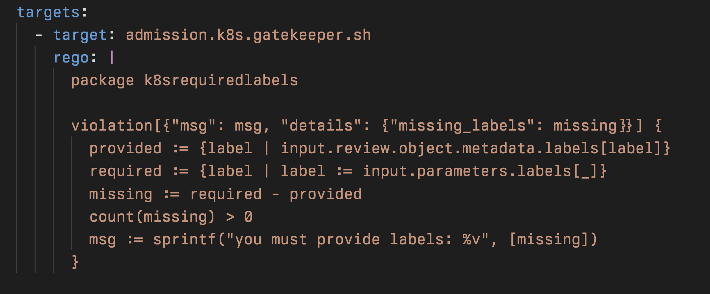

Slide 14
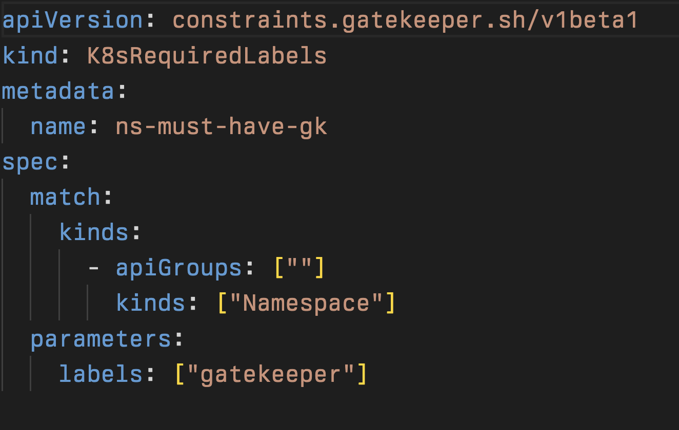

Slide 15


Slide 16
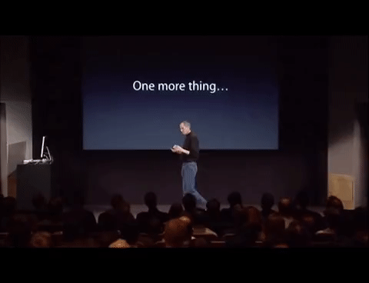
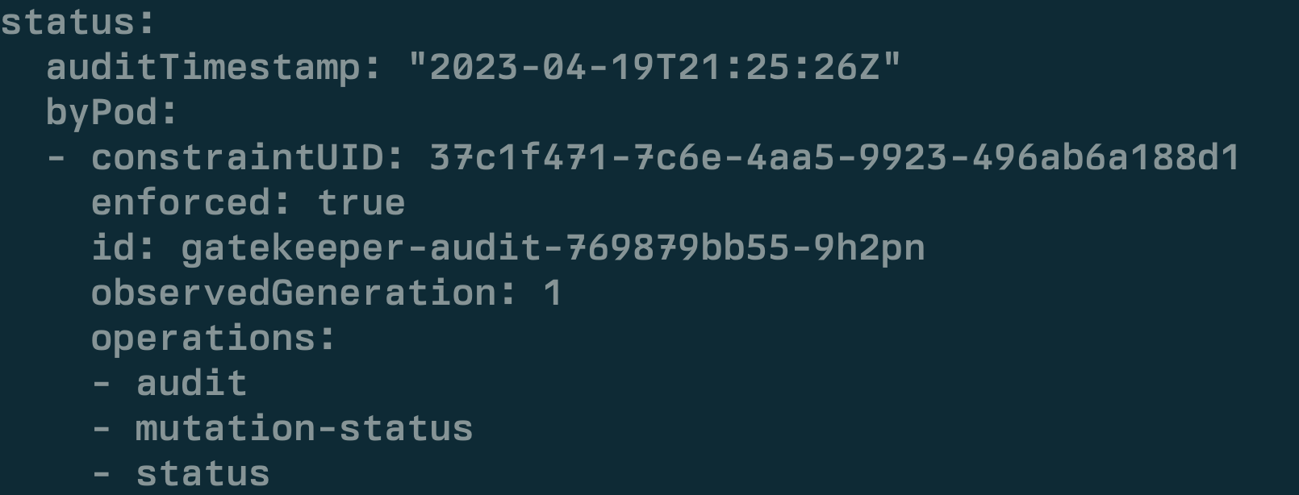
Auditing as well….

Slide 17
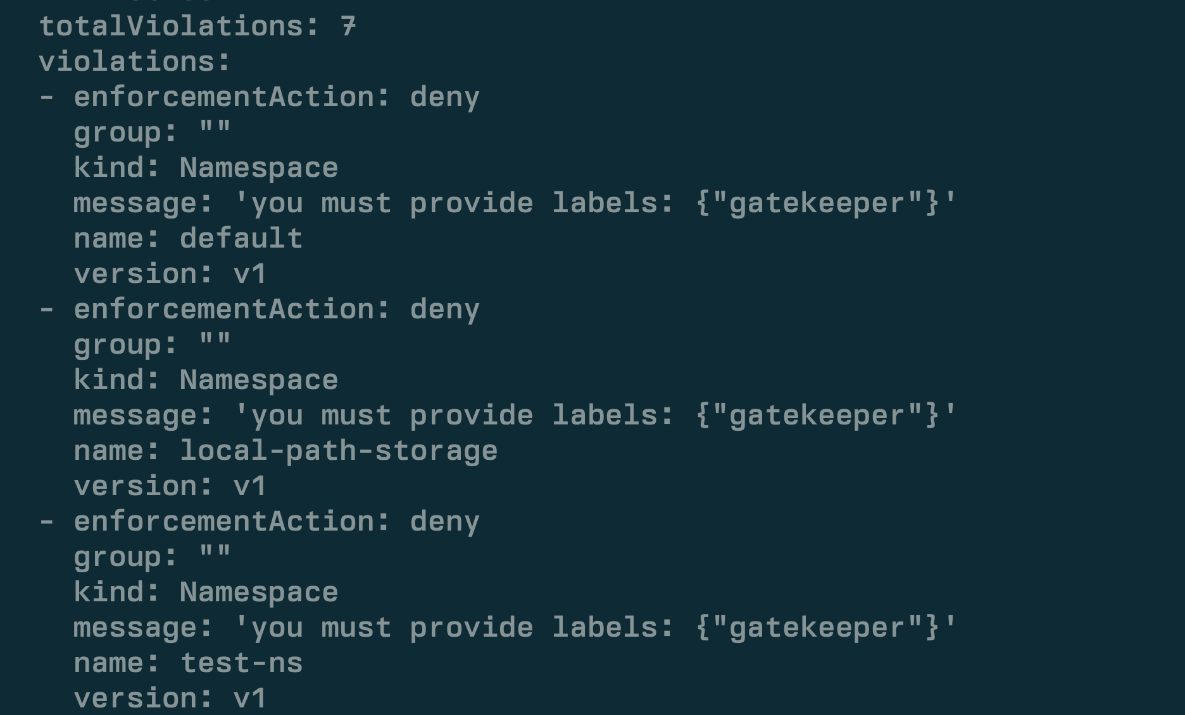

Slide 18
What about data that isn’t in my cluster?

Slide 19
Validate Integrity of Images?
Block Deployments Based On SBOMs?
Leverage Vulnerability Scans?

Slide 20
Gatekeeper External Data!
Your Cluster
Provider
Your Data Source
Admission Request

Slide 21
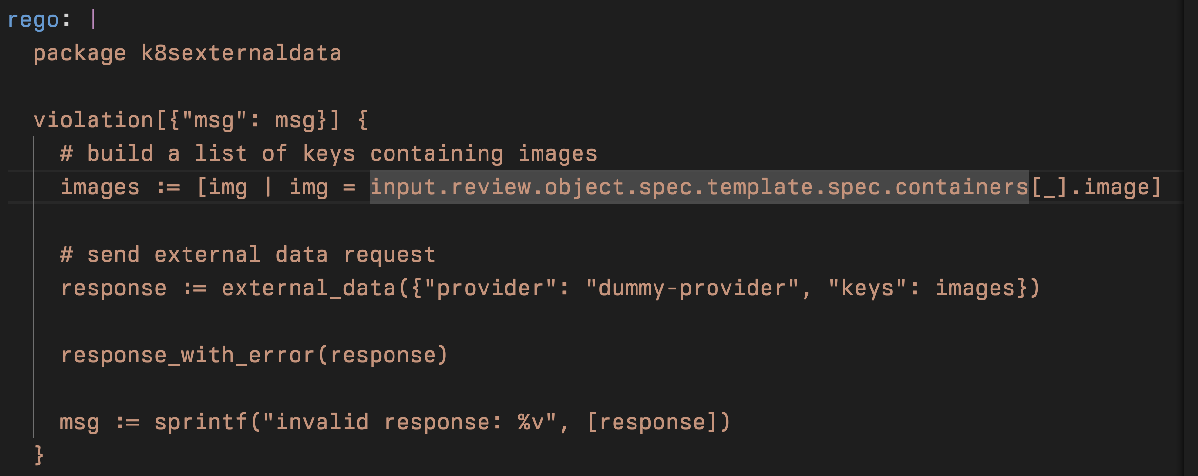

Slide 22
How Can We Distribute and Locate That Data?

Slide 23
OCI 1.1 - “Artifacts” and Referrers
- coming soon* to a registry near you

Slide 24
{
"mediaType": "application/vnd.oci.image.index.v1+json",
"schemaVersion": 2,
"manifests": [
{
"mediaType": "application/vnd.oci.image.manifest.v1+json",
"digest": "sha256:110ee10b81df282754bf52f913c9f171a2a8d4699ef18a8db6c82ab72ff38b17",
"size": 674,
"platform": {
"architecture": "amd64",
"os": "linux"
}
}
]
}
"schemaVersion": 2,
"mediaType": "application/vnd.oci.image.manifest.v1+json",
"config": {
"mediaType": "application/spdx+json",
"digest": "sha256:44136fa355b3678a1146ad16f7e8649e94fb4fc21fe77e8310c060f61caaff8a",
"size": 2
},
"layers": […],
"subject": {
"mediaType": "application/vnd.oci.image.index.v1+json",
"digest": "sha256:8920357d77a1c400c09fd846119e0eeea2f467d708f2813cb806c21b8f93610d",
"size": 1607
}
{

Slide 25
An Example Application

Slide 26
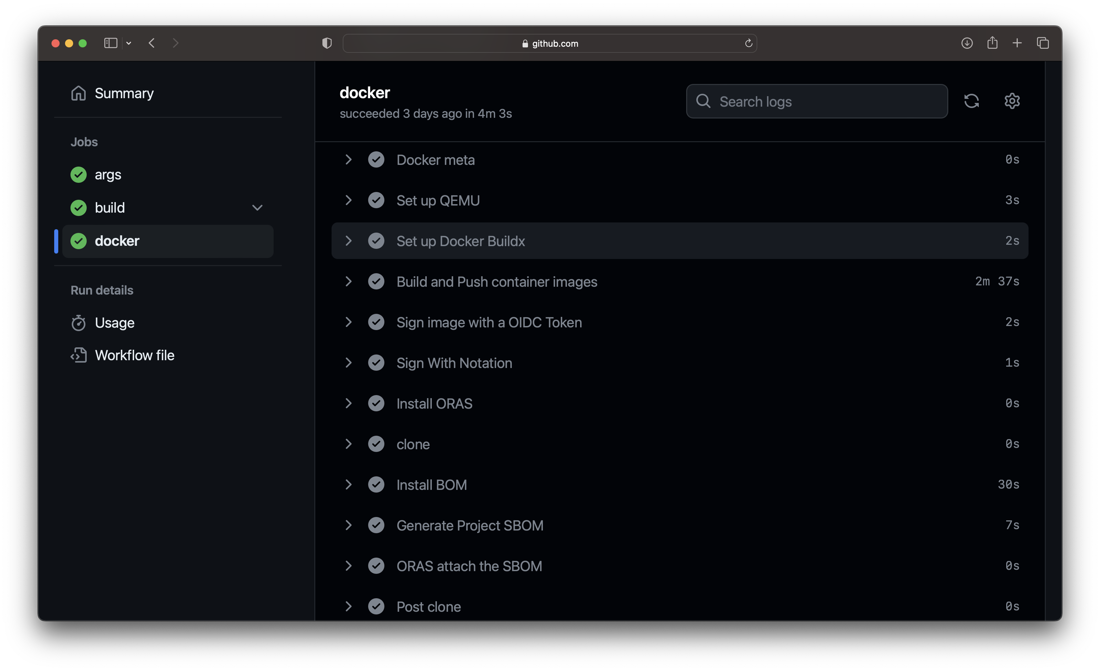

Slide 27


Slide 28
How do we write policies for these artifacts?

Slide 29
OK, Now What?
Meet Ratify.
A verification engine as a binary executable and on Kubernetes which
enables verification of artifact security metadata and admits for deployment only those that comply with policies you create.

Slide 30
Verifiers
type ReferenceVerifier interface {
Name() string
CanVerify(ctx context.Context, referenceDescriptor ocispecs.ReferenceDescriptor) bool
Verify(ctx context.Context,
subjectReference common.Reference,
referenceDescriptor ocispecs.ReferenceDescriptor,
referrerStore *referrerStore.Store,
executor executor.Executor
) (VerifierResult, error)
}

Slide 31
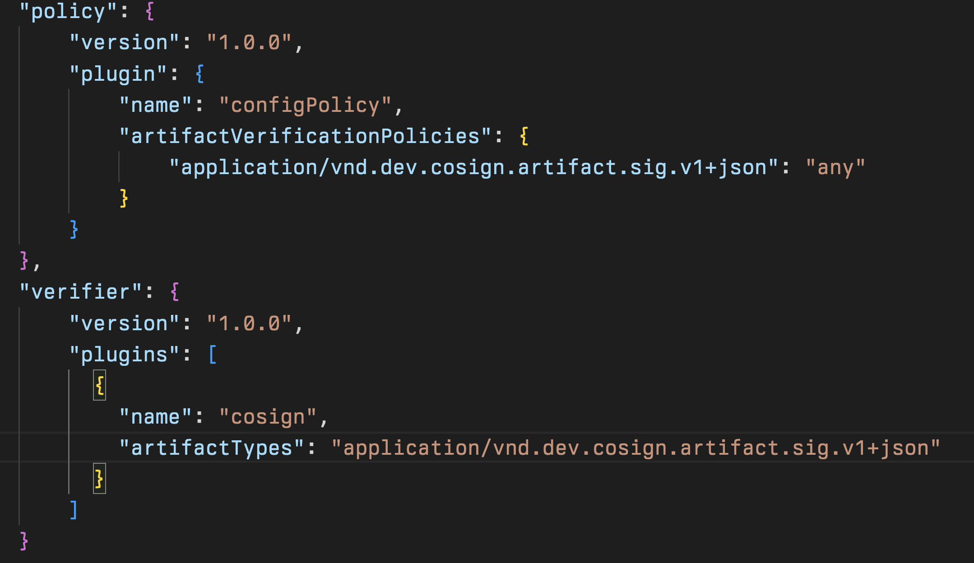

Slide 32
Let’s verify an image with cosign and Ratify!

Slide 34
Image Verification With Gatekeeper and Ratify

Slide 35
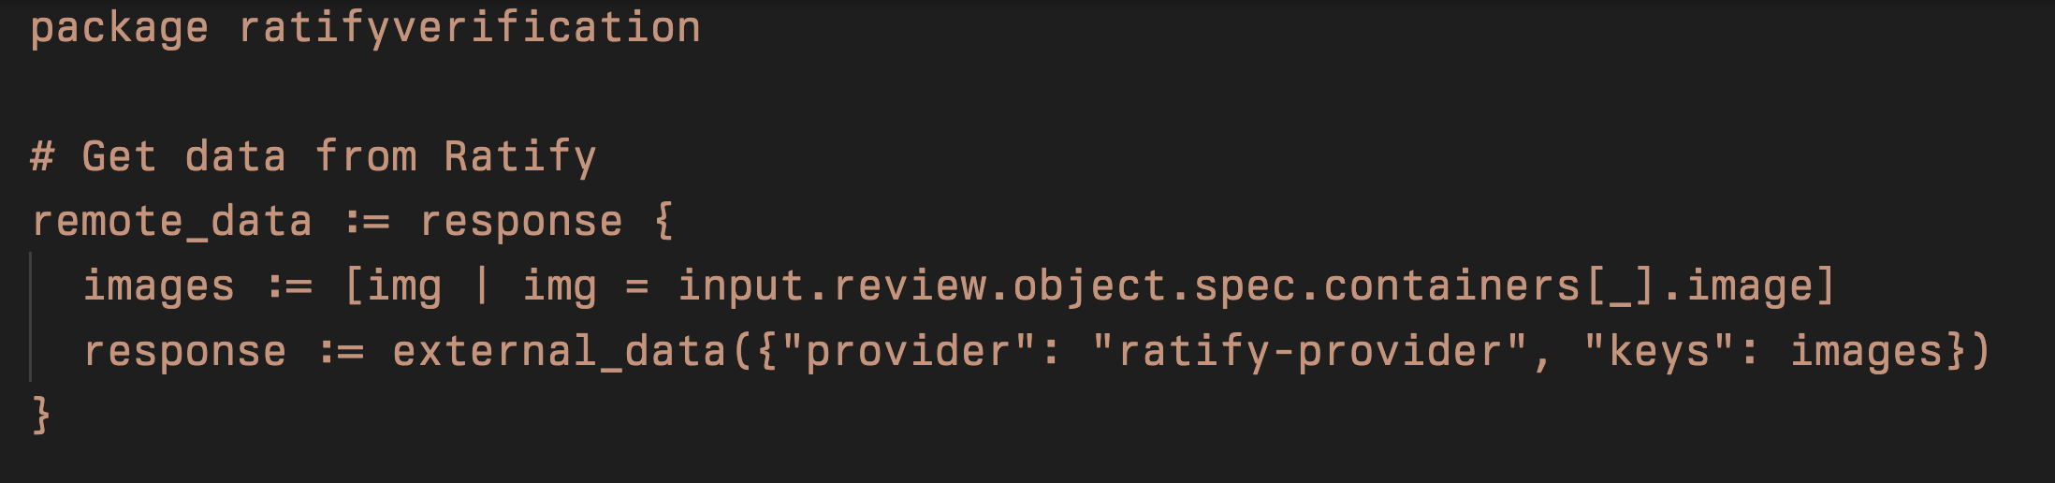
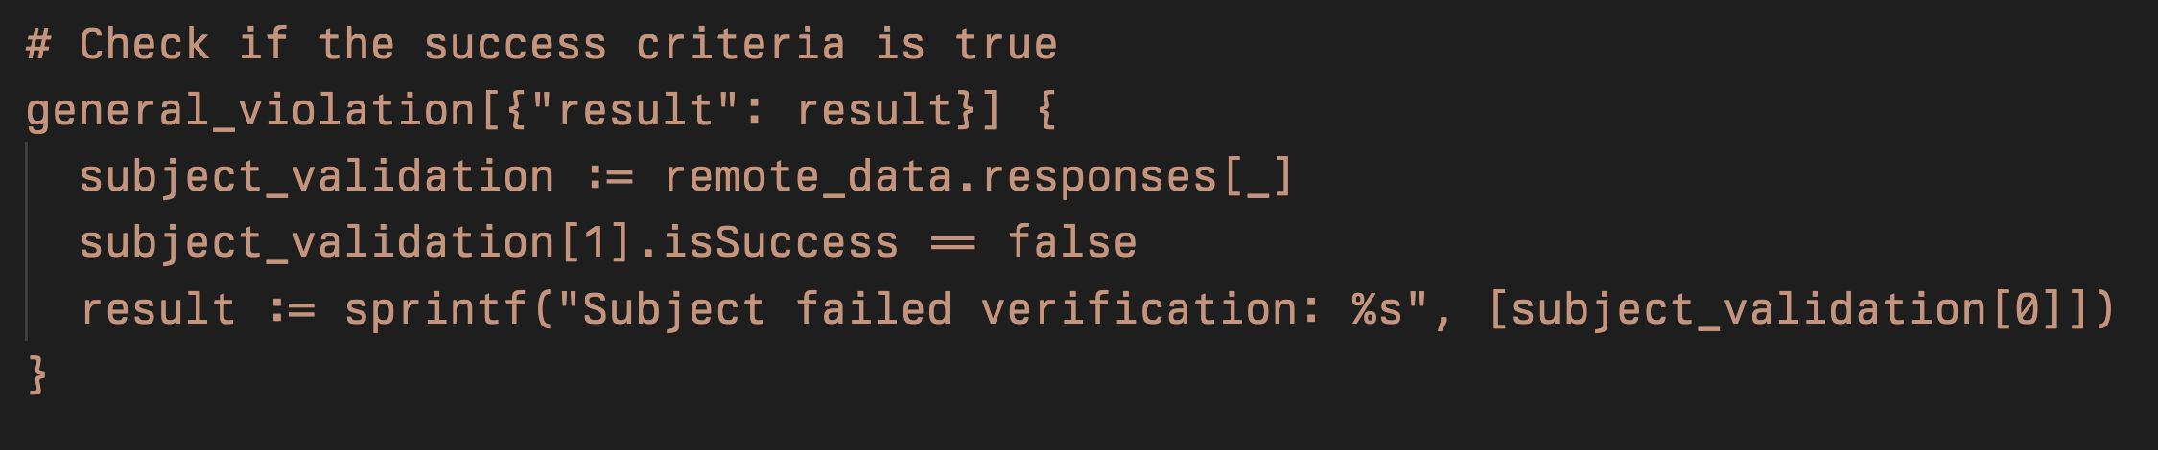

Slide 36
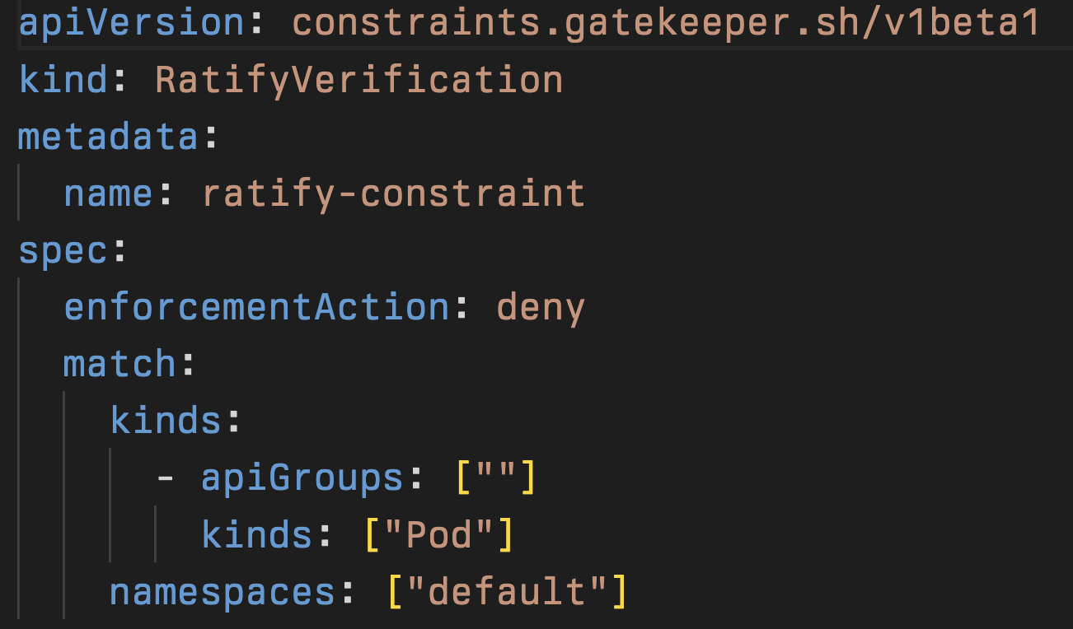

Slide 37
Gatekeeper + Ratify => Image Integrity

Slide 39
Let’s Go Deeper: New Use Case Block Licenses or Packages We Know Are Vulnerable
….with a custom verifier plugin!

Slide 40
Supporting Materials
https://open-policy-agent.github.io/gatekeeper/website/docs/howto/
https://open-policy-agent.github.io/gatekeeper/website/docs/next/externaldata/
https://github.com/opencontainers/image-spec/blob/main/manifest.md
https://github.com/deislabs/ratify/blob/main/docs/reference/dynamic-plugins.md

Slide 41

Please share your feedback!

Slide 42

Sponsor Shout-Out!
Thank you to our Session Recording Sponsor:

Slide 43
Bedankt!

